Slide 1
Jack Michael and the Multiple Effects of a Single Environmental Change
Comments
by
Mark L. Sundberg

Slide 2
Jack Michael
Learn to think and talk like Skinner
Then learn to think and talk like Jack
Jack liked animal analogs
Skinner’s analysis of verbal behavior is an essential component of being a behavior analyst
Jack was a stickler on terms. He placed a major focus on the technical vocabulary of behavior analysis, and was constantly refining this vocabulary (e.g., the MO)
He required that his students acquire and use precise technical vocabulary when analyzing behavior

Slide 3
Jack Michael on the Problems with the Term “Aversive”
“Many behavior analysts use the terms aversive stimulus or aversive control...The trouble with this omnibus term is that it has at least three different controlling variables. A stimulus may be called aversive because its offset functions as reinforcement, because its onset functions as punishment, or because it evokes the behavior that has in the past terminated it...This multiple meaning...works against unambiguous identification of functional relations, and it is not part of my own repertoire when I wish to speak precisely” (Michael, 1995, pp. 281-282; footnote)

Slide 4
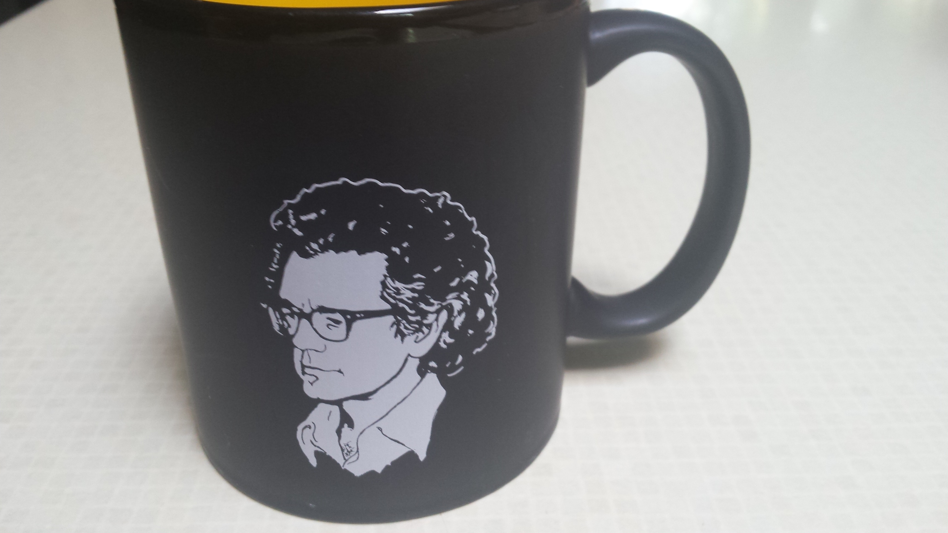
Jack Michael

Slide 5
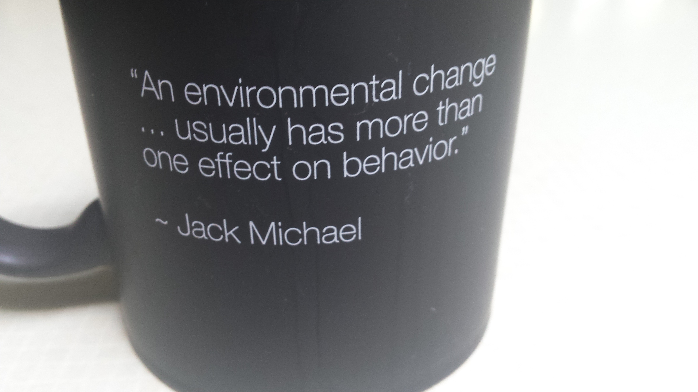
Jack Michael

Slide 6
Jack Michael Quotes
“An environment change, such as a stimulus onset or offset, usually has more than one effect on behavior” (Michael, 1995, p. 273)
“Being able to identify a functional relation with an appropriate term is an important part of our scientific repertoire” (p. 273)
“The development of a consistent and unambiguous repertoire regarding these terms and functional relations should be a major goal for a course in behavior analysis” (p. 273)
Michael, J. (1995). What every student of behavior analysis ought to learn: A system for classifying the multiple effects of behavioral variables. The Behavior Analyst, 18(2), 273-284.

Slide 7
Jack Michael
“There are 14 different kinds of effects that an environmental change can have on behavior” (Michael, 2004, p. 73)
Michael suggests that these effects can be classified into three major categories
Behavior-altering (immediate; evocative) versus function altering (long-lasting; conditioning) (see Schlinger & Blakely, 1987, 1994)
Respondent versus operant
Unlearned versus learned

Slide 8
Multiple Effects of an Environmental Change
Michael, J. (1983). Evocative and repertoire altering effects of an environmental event. The Analysis of Verbal Behavior, 2, 19-21.
Michael, J. (1986). Repertoire-altering effects of remote contingencies. The Analysis of Verbal Behavior, 4, 10-18.
Michael, J. (1995). What every student of behavior analysis ought to learn: A system for classifying the multiple effects of behavioral variables. The Behavior Analyst, 18(2), 273-284.
Michael, J. L. (2004). Concepts and principles of behavior analysis (Rev. ed.). Kalamazoo, MI: Association for Behavior Analysis International.
Michael, J., Palmer, D. C., & Sundberg, M. L. (2011). The multiple control of verbal behavior. The Analysis of Verbal Behavior, 27, 3-22.
Schlinger, H. D., & Blakely, E. (1987). Function-altering effects of contingency specifying stimuli. The Behavior Analyst, 10, 41–45.
Schlinger, H. D., & Blakely, E. (1994). A descriptive taxonomy of environmental operations and its implications for behavior analysis. The Behavior Analyst, 17, 43–57.

Slide 9
Jack Michael’s 14 Effects
Behavior altering (evocative)
Unconditioned elicitor
Conditioned elicitor
Unconditioned motivator
Conditioned motivator (Surrogate, transitive, reflexive)
Discriminative stimulus (S^{D}-- reinforcement; S^{D} --punishment)
Function altering (lasting change)
Unconditioned conditioner
Conditioned conditioner
Unconditioned reinforcement
Conditioned reinforcement
Unconditioned punishment
Conditioned punishment

Slide 10
Jack Michael
Michael (2004) also identified three additional function altering effects
Pairing for a new S^{r}, S^{p}, & CMO-S
Pairing in a response-consequence contingency for a new S^{D}, CMO-T, & CMO-R
Unpairing weakens the effects (extinction)
Schlinger & Blakely suggest several other function altering effects, for example;
Conditional discriminations
Verbal function-altering operations
Operations that result in observational learning

Slide 11
“An environmental change...usually has more than one effect on behavior” (Michael, 1995, p. 273)
Convergent
multiple control
Function alt.
Behavior altering
Overt or Covert
MO
New S^{D}
Divergent
multiple control
Tact
Verbal S^{D}
Mand to peers
Verbal S^{D}
.....
Nonverbal S^{D}
Charlie
Throwing
toys
IV S^{D}
Dog
S^{D}
S^{p}
S^{D}1
Single stimulus change: Song from an ice cream truck
Nonverbal S^{D}
Running
Nonverbal S^{D}
S^{D}
Verbal S^{D}
Echoic
Charlie
Throwing
toys
S^{r}
Verbal S^{D}
Intraverbal
Novel audience
Joey
CEO-T
CS
Mand
New S^{D}
Pairing
Salivation
Function alt.
Cuckoo Clock
New S^{D}
Function alt.
New CS
New S^{r}
Function alt.
New Auto S^{r}
Function alt.
Mark Sundberg, ABI, May, 31, 2016
Function alt.

Slide 12
Jack Michael Quote
“One might ask why it is of any value to be able to recognize and correctly name these various effects. I would answer that I have found, for myself, at least, that I cannot understand some of these things unless I can talk about them clearly. I cannot think clearly about nonverbal events unless I have a consistent verbal repertoire regarding those events. Perhaps I should be more intuitive or contingency shaped and less rule governed, but my intuition tells me otherwise” (Michael, 1995, p. 284)

